Slide 1

Wi-fi Talking Robot
Presented by:
Summiya(2212143)
Shahriyar
Muzammil

Slide 2
OVERVIEW
Objective
Abstract
Existing system
Block diagram
Implementation
Expected outcome

Slide 3
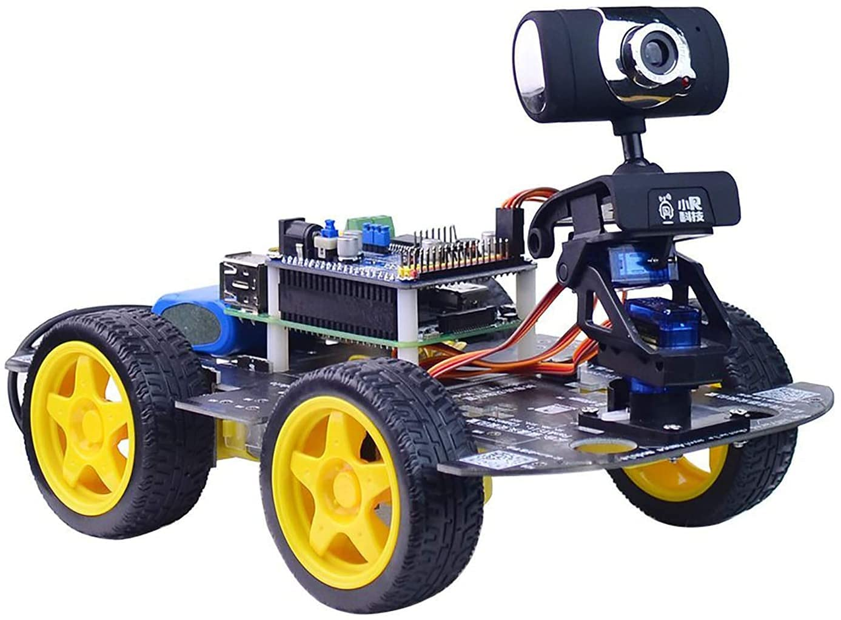
OBJECTIVE
The main object of the project is to build a Wireless robot which can be controlled by a voice command of a person.
The idea is to create a sort of robot which going to be driven by voice commands.
The main objective of voice controlled robotic vehicle (VCRV) is to listen and act on the commands of the user.

Slide 4
ABSTRACT
This project was developed in a way that the robot is controlled by voice commands.
As robotic technology continues to advance , robots are becoming capable of performing ever more complex tasks.
The connection between the android app and the vehicle is facilitated with Bluetooth technology.
The robot is controlled by buttons on the application or by spoken commands of the user.
We use motor drivers to give high power to the motor by using a small voltage signal from a microcontroller or a control system.

Slide 5
EXISTING SYSTEMS This project is to design and develop a robot that is controlled by voice commands. The robot is designed to move as per the command given by the controller. To move in all the direction like forward, reverse, left and right. The voice are monitored at the android phone. The connection between the android app and the vehicle is facilitated with Bluetooth technology. The robot is controlled by buttons on the application or by spoken commands of the user. The commands from the application is converted in to digital signals by the Bluetooth RF transmitter for an appropriate range (about 100 meters) to the robot.

Slide 6
PROPOSED SYSTEM the system is more useful for person.our intention is to make a robotic vehicle with use of advanced smartphone technology in a very simple and economic way.

Slide 7
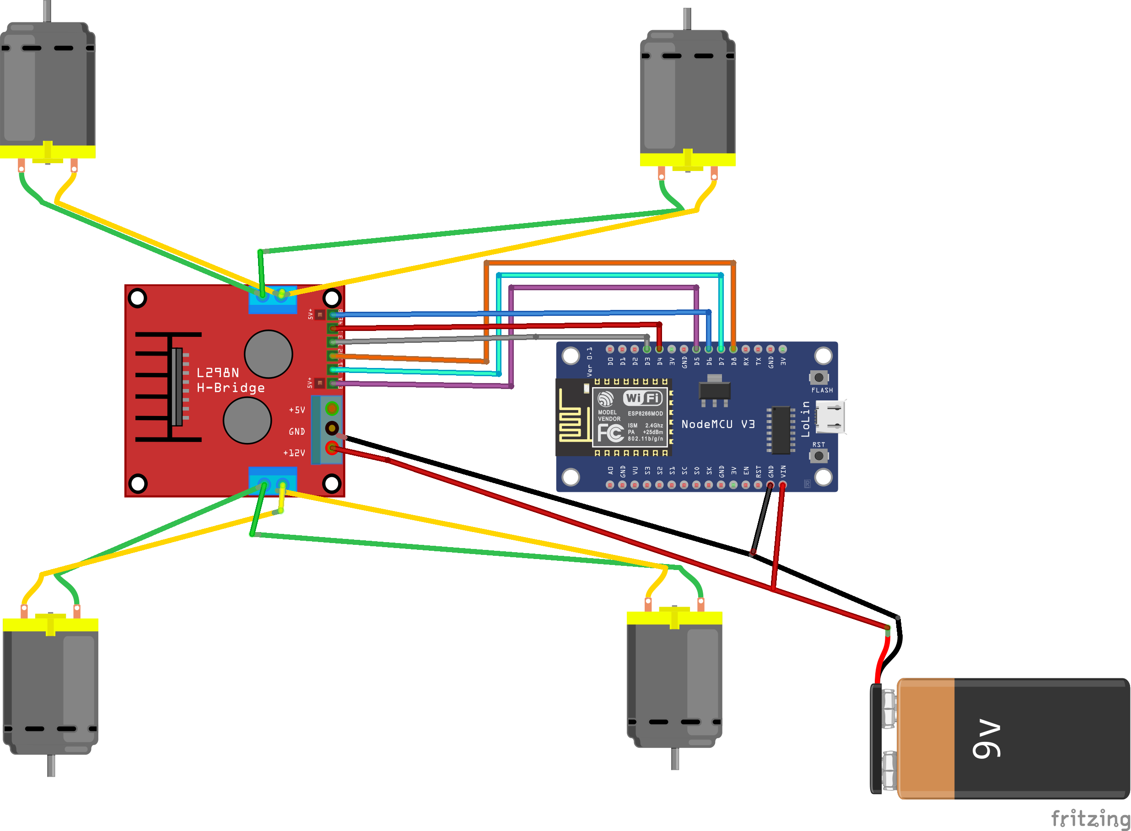
Block Diagram

Slide 8
Implimentation

Slide 9
Large Image slide

Slide 10
Video slide
Expected outcome
The ROBO moves in all four directions:
Left, Right, Front, Back.
The movement of the robot is manually controlled through mobile.

Slide 11


Thank You
Jens Martensson
jens@bellowscollege.com

